Slide 1


INTRODUCTION TO Vision and Scope document LAB: 2
COURSE : SOFTWARE CONSTRUCTION
Prepared and Presented By: Engr. HAMZA

Slide 2

objectives
After completing this lab the student should be able to:
Clearly understand the purpose writing Vision and Scope Document.
To elicit and document the Vision and Scope Business Requirements of a project.

Slide 3

Introduction to vision and scope document
Vision and Scope Document:
Gathers business requirements into a single deliverable.
Sets the foundation for subsequent development work.
Owned by the project's executive sponsor, funding authority, or a similar role.
Collaboration with a business analyst to articulate requirements and create the document.
Input for business requirements should come from individuals who understand the project's purpose.
Input sources may include senior management, product visionary, product manager, subject matter experts, or marketing department.
- Template for Vision and Scope Document (Figure 3-1):
Adapt to meet project-specific needs.
Avoid duplication of information already recorded elsewhere.
Reusable elements like business objectives, risks, and stakeholder profiles can be carried over from project to project.

Slide 4

Why vision and scope documents are created
A Vision and Scope Document is created to:
Define the project's purpose and objectives.
Manage stakeholder expectations.
Align the project with business goals.
Control project scope to prevent unnecessary changes.
Allocate resources effectively.
Identify and manage project risks.
Facilitate clear communication among stakeholders.
Aid decision-making during the project.
Guide project planning and accountability.
Serve as documentation for historical reference and compliance.

Slide 5

Example with real world:
Imagine you're opening a new restaurant. Your Vision and Scope Document is like the menu, which clearly defines what dishes and drinks you'll offer (scope) and what you won't (limitations). It sets expectations for both your customers and your kitchen staff, preventing confusion and ensuring a smoother dining experience.

Slide 6

Importance of vision and scope document
Blueprint for Clarity: You start by creating a detailed itinerary and route map. This itinerary is like your Vision and Scope Document, outlining the purpose of your trip (exploring national parks), the objectives (visiting specific parks), and the boundaries (not veering too far from the planned route).
Preventing Unwanted Changes: Without a clear itinerary, you might end up constantly changing your route, adding more destinations, and extending your trip. However, with your well-defined plan, you're less likely to suffer from "scope creep" during your journey.
Alignment with Objectives: Your trip's purpose aligns with your personal goal of exploring nature and national parks. You ensure that your itinerary fulfills this objective, similar to how a Vision and Scope Document ensures a project aligns with an organization's goals.
Resource Efficiency: Your itinerary helps you allocate resources effectively, such as budgeting for accommodations, planning refueling stops, and knowing when and where to eat. Just as in a project, a clear scope helps allocate resources efficiently.
Risk Management: You anticipate potential risks, such as weather disruptions or road closures, and have contingency plans in place. Similarly, a Vision and Scope Document identifies project risks and strategies to address them.

Slide 7
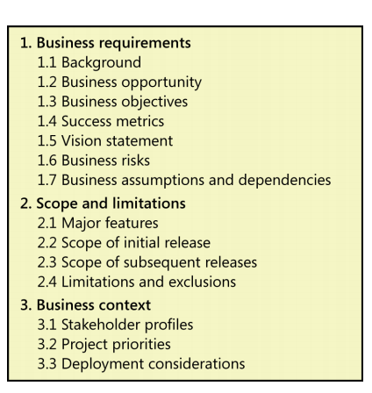
Business requirements
Business Requirements:
Projects are launched in the belief that creating or changing a product will provide worthwhile benefits for someone and a suitable return on investment. The business requirements describe the primary benefits that the new system will provide to its sponsors, buyers, and users. Business requirements directly influence which user requirements to implement and in what sequence.

Slide 8
Background:
1.1 Background
Summarize the rationale and context for the new product or for changes to be made to an existing one. Describe the history or situation that led to the decision to build this product.

Slide 9
Business opportunity
1.2 Business opportunity
For a corporate information system, describe the business problem that is being solved or the process being improved, as well as the environment in which the system will be used. For a commercial product, describe the business opportunity that exists and the market in which the product will be competing. This section could include a comparative evaluation of existing products, indicating why the proposed product is attractive and the advantages it provides. Describe the problems that cannot currently be solved without the envisioned solution. Show how it aligns with market trends, technology evolution, or corporate strategic directions. List any other technologies, processes, or resources required to provide a complete customer solution. Describe the needs of typical customers or of the target market. Present customer problems that the new product will address. Provide examples of how customers would use the product.

Slide 10
Example: A Restaurant Embracing Food Delivery Services
Suppose there's a family-owned restaurant that has been operating successfully as a dine-in establishment for many years. However, in response to changing consumer behavior and the impact of the COVID-19 pandemic, the restaurant decides to explore a new business opportunity: food delivery services.
Benefits of the Business Opportunity:
Expanded Customer Base: By offering food delivery, the restaurant can reach a broader customer base beyond those who prefer dining in. This includes individuals who prefer the convenience of ordering food to their homes or workplaces.
Adaptation to Market Trends: Recognizing the increasing demand for food delivery services, especially during the pandemic, allows the restaurant to align with current market trends.
Revenue Diversification: Food delivery services provide an additional revenue stream. This diversification can help stabilize the restaurant's income, especially during periods of reduced dine-in traffic.
Enhanced Brand Visibility: Partnering with popular food delivery platforms or creating a dedicated delivery app can increase the restaurant's visibility in the local market and attract new customers.
Competitive Advantage: Offering delivery services can give the restaurant a competitive edge over competitors who have not yet ventured into this space.

Slide 11
Business objective and vision statement
1.3 Business objectives
Summarize the important business benefits the product will provide in a quantitative and measurable way.
1.4 Vision statement
Write a concise vision statement that summarizes the long-term purpose and intent of the product. The vision statement should reflect a balanced view that will satisfy the expectations of diverse stakeholders. It can be somewhat idealistic but should be grounded in the realities of existing or anticipated markets, enterprise architectures, corporate strategic directions, and resource limitations
The following keyword template works well for crafting a product vision statement (Moore 2002):
For [target customer]
Who [statement of the need or opportunity]
The [product name]
Is [product category]
That [major capabilities, key benefit, compelling reason to buy or use]
Unlike [primary competitive alternative, current system, current business process]
Our product [statement of primary differentiation and advantages of new product]

Slide 12
Example:
Here’s a sample vision statement for the Chemical Tracking System, with the keywords in boldface:
For scientists who need to request containers of chemicals, the Chemical Tracking System is an information system that will provide a single point of access to the chemical stockroom and to vendors. The system will store the location of every chemical container within the company, the quantity of material remaining in it, and the complete history of each container’s locations and usage. This system will save the company 25 percent on chemical costs in the first year of use by allowing the company to fully exploit chemicals that are already available within the company, dispose of fewer partially used or expired containers, and use a standard chemical purchasing process. Unlike the current manual ordering processes, our product will generate all reports required to comply with federal and state government regulations that require the reporting of chemical usage, storage, and disposal

Slide 13
Business risk
1.6 Business risks
Summarize the major business risks associated with developing—or not developing—this product. Risk categories include marketplace competition, timing issues, user acceptance, implementation issues, and possible negative impacts on the business. Business risks are not the same as project risks, which often include resource availability concerns and technology factors. Estimate the potential loss from each risk, the likelihood of it occurring, and any potential mitigation actions

Slide 14
Real world example
Market Risk: Changes in market conditions, customer preferences, or industry trends can impact sales and profitability.
Financial Risk: This includes risks related to funding, such as debt obligations, interest rate fluctuations, or lack of capital for expansion.
Operational Risk: Issues with day-to-day operations, such as supply chain disruptions, technology failures, or employee errors, can disrupt business activities.
Compliance and Regulatory Risk: Failing to comply with laws and regulations can lead to legal consequences, fines, or damage to the company's reputation.
Reputation Risk: Negative publicity, customer complaints, or ethical concerns can harm a company's reputation.
Competitive Risk: Increased competition can erode market share and pricing power.
Cybersecurity Risk: Data breaches and cyberattacks can result in data loss, financial losses, and damage to the company's reputation.
Economic Risk: Economic downturns, inflation, or currency fluctuations can affect revenue and costs.
Supply Chain Risk: Disruptions in the supply chain due to factors like natural disasters or geopolitical events can impact production and delivery.
Talent and Human Resource Risk: Challenges in hiring, retaining, and managing talent can affect business performance.

Slide 15
Business assumptions and dependencies
1.7 Business assumptions and dependencies
Assumptions in business refer to unverified statements considered true in the absence of concrete evidence.
Business assumptions are closely tied to business requirements and can impact the achievement of objectives.
Incorrect assumptions may necessitate scope adjustments, scheduling changes, or the initiation of additional projects.
Stakeholders should document the assumptions made during project conception and scope definition.
Major dependencies on external factors, such as industry standards, government regulations, third-party suppliers, or partner contributions, should also be recorded.
Some business assumptions and dependencies may evolve into project risks that require ongoing monitoring.
Broken dependencies frequently lead to project delays, highlighting their critical importance.
Stakeholders should understand the potential impacts of untrue assumptions or broken dependencies on the project's success.

Slide 16
Appendix B includes an example vision and scope document written according to this template.

Slide 17

Scope and limitations
In both chemistry and software projects, defining scope and limitations is crucial.
Just as a chemist outlines what a new reaction can and cannot achieve, a software project must specify its solution's boundaries.
Establishing business requirements is essential to prevent scope creep, which is the uncontrolled expansion of project functionality.
Scope defines the concept and range of the proposed solution, while limitations clarify what the product will not include.
Clearly defined scope and limitations manage stakeholder expectations and prevent costly or out-of-scope feature requests.
Scope is determined at different levels, from high-level business objectives to detailed functional requirements.
Each lower-level scope must align with and stay within the boundaries of the level above it.
For example, functional requirements must relate to user requirements, which in turn must align with the project's business objectives.

Slide 18

Major features:
List the product’s major features or user capabilities, emphasizing those that distinguish it from previous or competing products. Think about how users will use the features, to ensure that the list is complete and that it does not include unnecessary features that sound interesting but don’t provide customer value. Give each feature a unique and persistent label to permit tracing it to other system elements. You might include a feature tree diagram, as described later in this chapter.

Slide 19
Scope and initial release:
The scope of the initial product release outlines the planned capabilities to be included.
Scope can be defined in terms of features, user stories, use cases, use case flows, or external events.
Quality characteristics necessary for the product to deliver intended benefits to user classes should be described.
Avoid the temptation to include every potential feature in the first release to prevent bloatware and schedule delays.
Focus on features that provide the most value at an acceptable cost and within a reasonable time frame.
An example is given where a package delivery software's initial release prioritized reliability over speed, aesthetics, or ease of use.
Nonfunctional requirements, especially those impacting architecture, should not be neglected in the initial release to avoid costly re-architecting in the future.

Slide 20
Scope of subsequent releases:
For a product with a staged evolution or following an iterative/incremental life cycle, create a release roadmap.
The roadmap should indicate which functionality will be deferred and when subsequent releases are planned.
Subsequent releases allow the implementation of additional use cases, features, and enhancements to initial functionalities.
Future scope statements for subsequent releases become less precise the farther into the future they go, and they are subject to change over time.
Flexibility is necessary, as functionality may shift between planned releases, and unexpected capabilities may be added.
Short release cycles provide frequent opportunities to incorporate customer feedback and make adjustments accordingly.

Slide 21
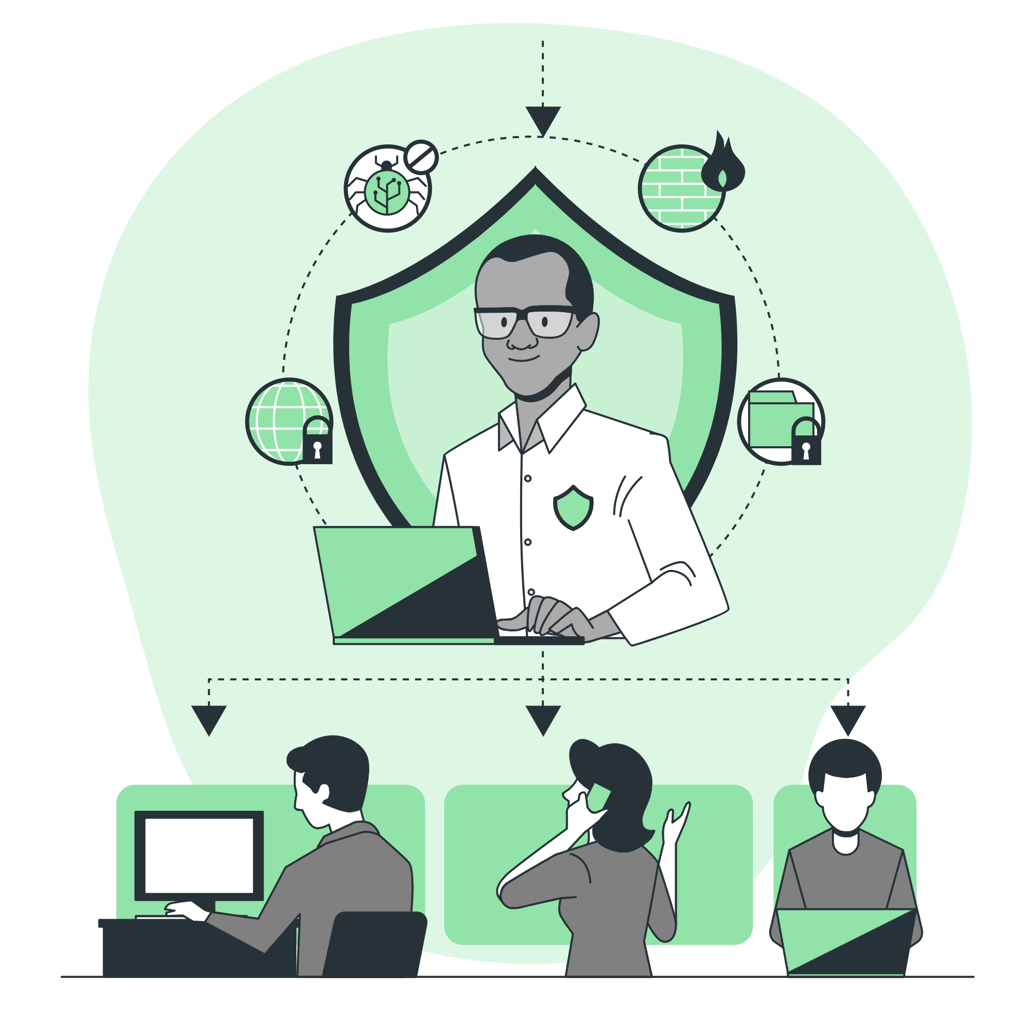
Limitations and exclusions:
The "Limitations and Exclusions" section of the project documentation should explicitly list product capabilities or characteristics that stakeholders might expect but are not planned for inclusion.
It serves as a reminder of items that were initially considered but later cut from the scope.
This section ensures that scope decisions are documented and not forgotten.
For example, if mobile platform support was requested but deemed out of scope, it should be explicitly stated in this section.

Slide 22

Tools used for this lab:
Tools:
Microsoft Word: Microsoft Word is a versatile tool for creating documents, including Vision and Scope Documents. It provides templates and formatting options for professional documentation.
Project Management Software: Project management tool like Trello often have features for creating and managing project documentation, including Vision and Scope Documents.
Online Collaboration Platforms: Platforms like Notion provide collaborative environments for creating, editing, and sharing project documents.

Slide 23

Ms word:

Slide 24
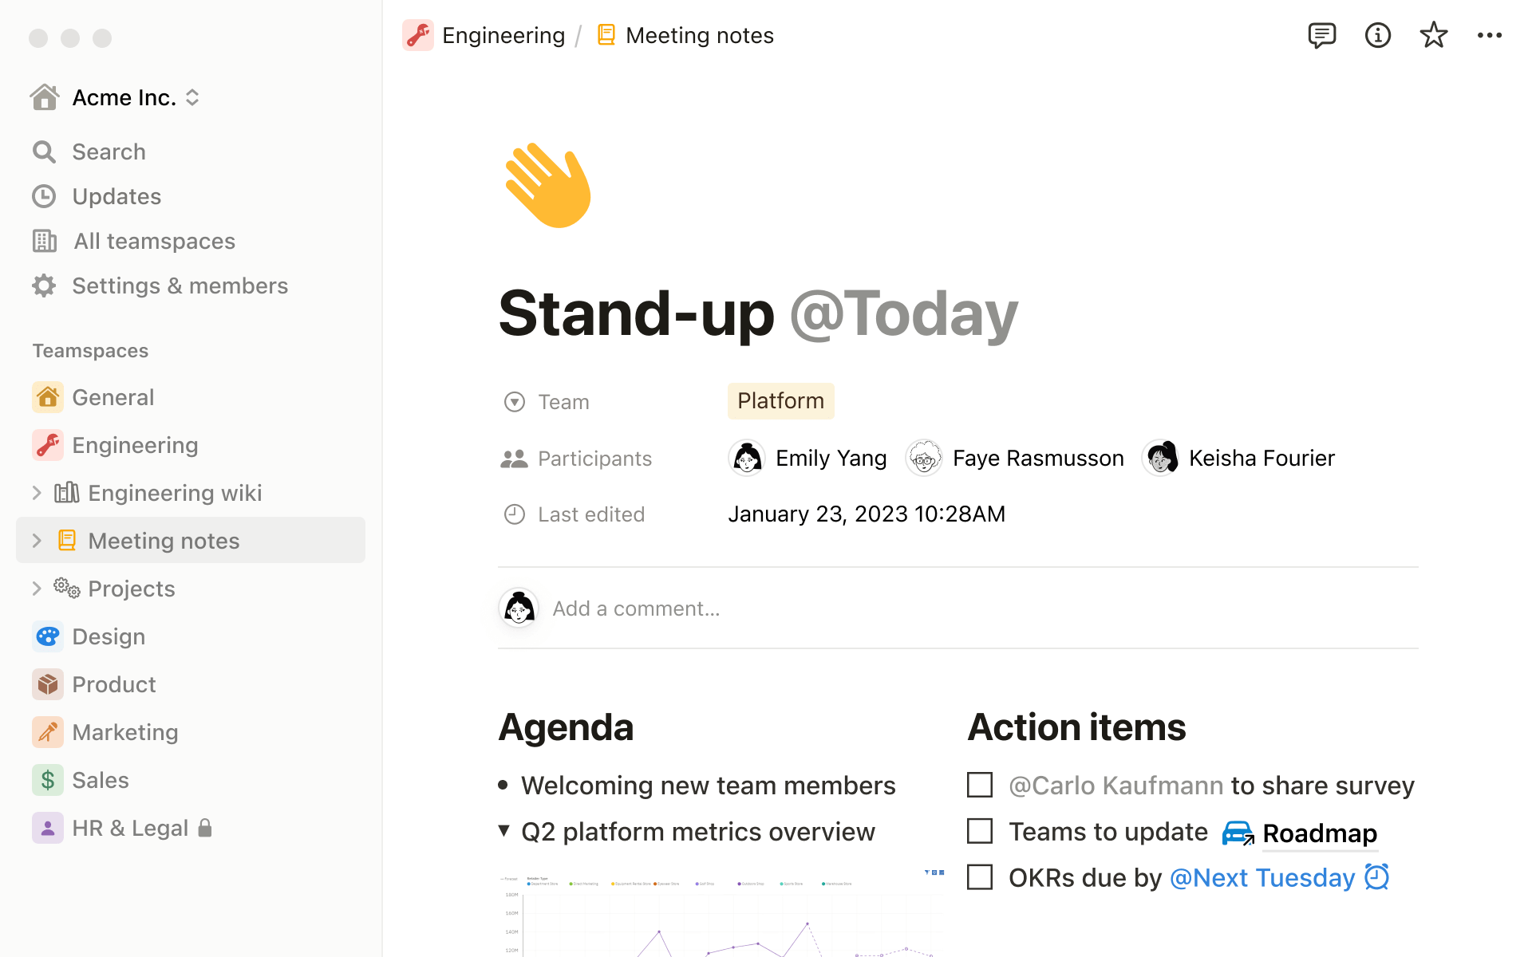
Notion:

Slide 25
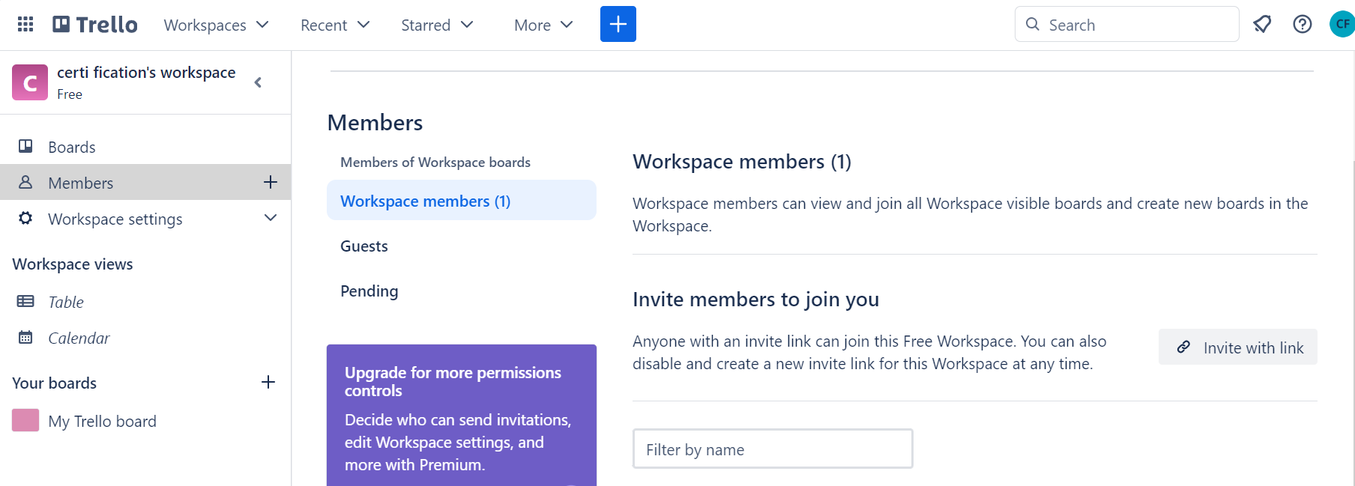
trello

Slide 26
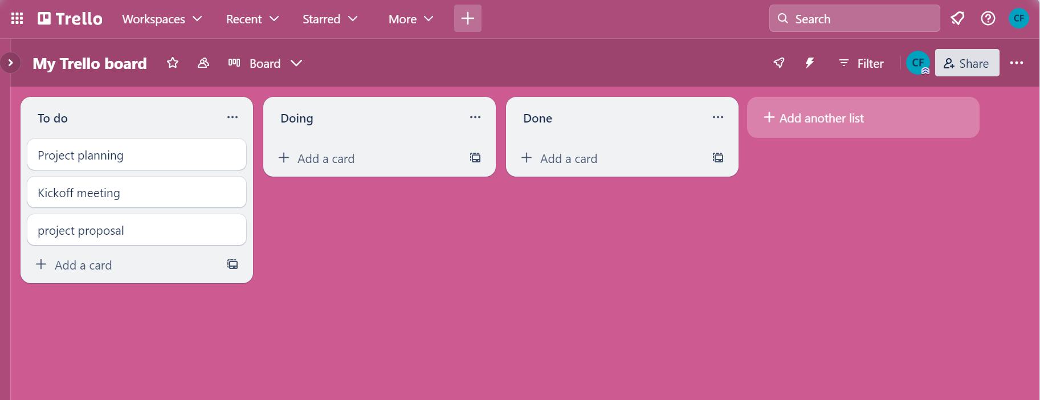
continue :

Slide 27
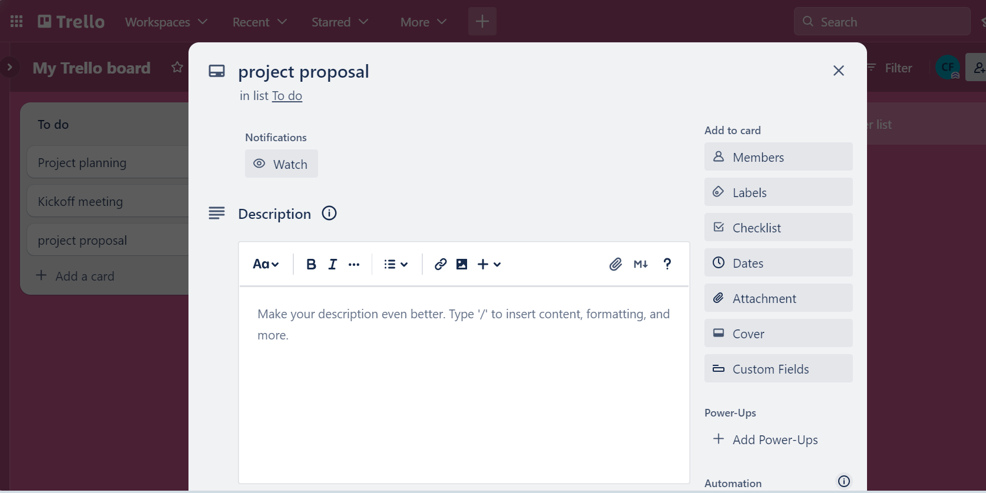
continue :

Slide 28
Tasks 1:
Visit your clients and discuss the Project’s Vision and scope. Gather the Project’s business requirements from your clients. Document the business requirements. Present it to the instructor. Once you have discussed the Project’s Vision and scope. Elicit the Project’s Scope and Business context. Document the Project’s Scope and Business context.

Slide 29

Task 2 :
Submit the complete document of Vision & Scope of your project.

Slide 30

THANK YOU

